Slide 1
Class 7: Graph Neural Networks for Weather Forecasting

Slide 2

Outline
Motivation
Recap of sequence models
Graph basics & adjacency matrices
Basic Graph propagation rule
Message passing intuition
Graph Attention (GAT) example

Slide 3
Motivation & Recap: why graphs?
Sequence models (LSTMs, Transformers) capture temporal patterns but ignore spatial relationships among distributed sensors
Weather data form an (ir)regular network where nearby stations/grid points influence each other more than distant ones
Graph Neural Networks jointly learn from node (and edge) features and edge structure to model spatial correlations
 | Sequence Models | Graph Models
Structure | Linear (time) | Irregular (nodes & edges)
Dependencies | Temporal only | Spatial & temporal
Applications | Time‑series forecasting | Networks: social, transport, weather

Slide 4
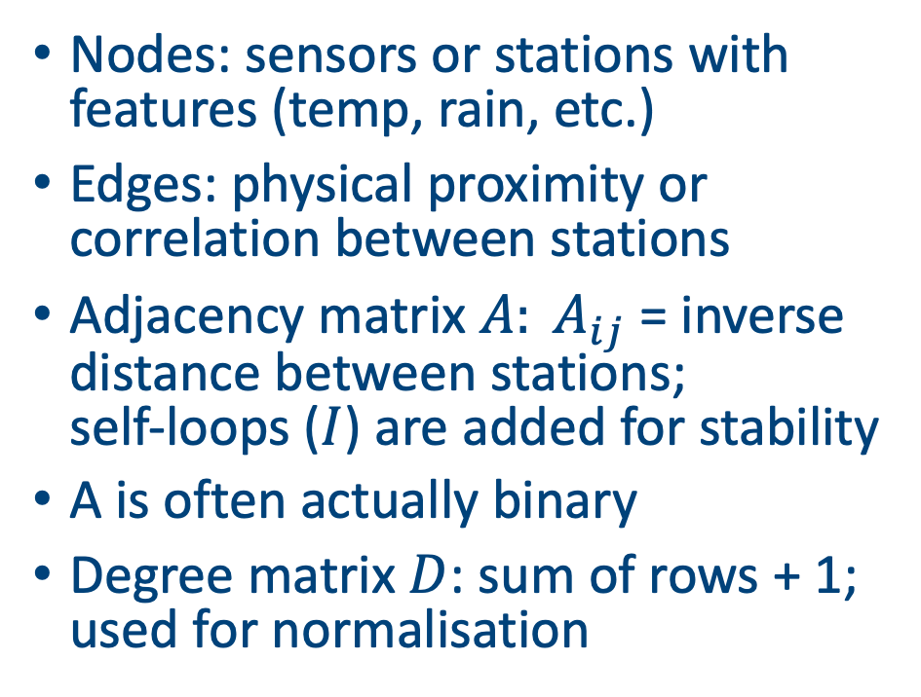
Graph basics
Nodes: sensors or stations with features (temp, rain, etc.)
Edges: physical proximity or correlation between stations
Adjacency matrix $A: A_{ij}$ = inverse distance between stations; self‑loops ($I$) are added for stability
A is often actually binary
Degree matrix $D$: sum of rows + 1; used for normalisation
 | Athlone | Belfast | Cork
Athlone | 0 | 1 | 0.5
Belfast | 1 | 0 | 0.2
Cork | 0.5 | 0.2 | 0
B
A
C

Slide 5
Task
Given a set of weather observations at each station, predict the temperature at the next time point
Idea: use the fact that some stations are closer than others to create the predictions
Try and fit into the world of NNs and embeddings. We are always looking to create hidden neurons that capture the important aspects of the data

Slide 6
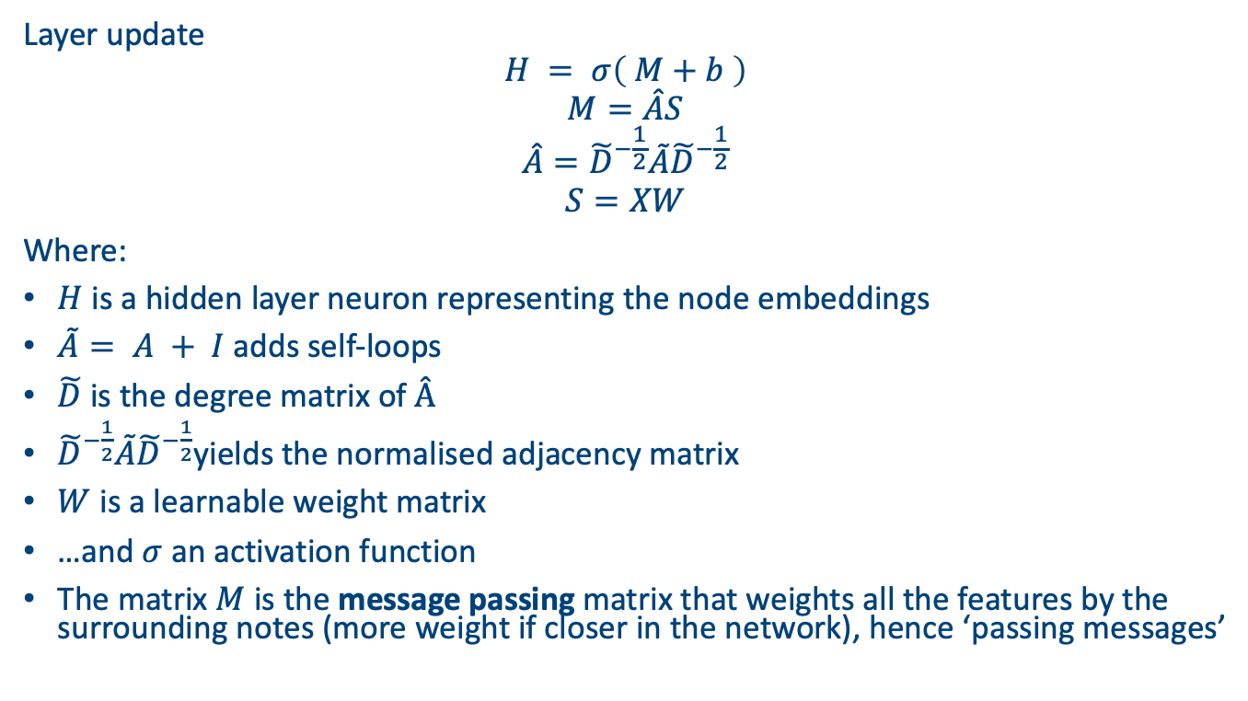
Simplified method
Layer update
$$H = σ\left( M+b \right)$$
$$M=\hat{A}S$$
$$\hat{A}={\tilde{D}}^{−\frac{1}{2}}\tilde{A}{\tilde{D}}^{−\frac{1}{2}}$$
$$S=XW$$
Where:
$H$ is a hidden layer neuron representing the node embeddings
$\tilde{A}= A + I$adds self‑loops
$\tilde{D}$is the degree matrix of $Â$
${\tilde{D}}^{−\frac{1}{2}}\tilde{A}{\tilde{D}}^{−\frac{1}{2}}$yields the normalised adjacency matrix
$W$ is a learnable weight matrix
…and $σ$ an activation function
The matrix $M$ is the message passing matrix that weights all the features by the surrounding notes (more weight if closer in the network), hence ‘passing messages’

Slide 7
GNN example
Go through on the board

Slide 8
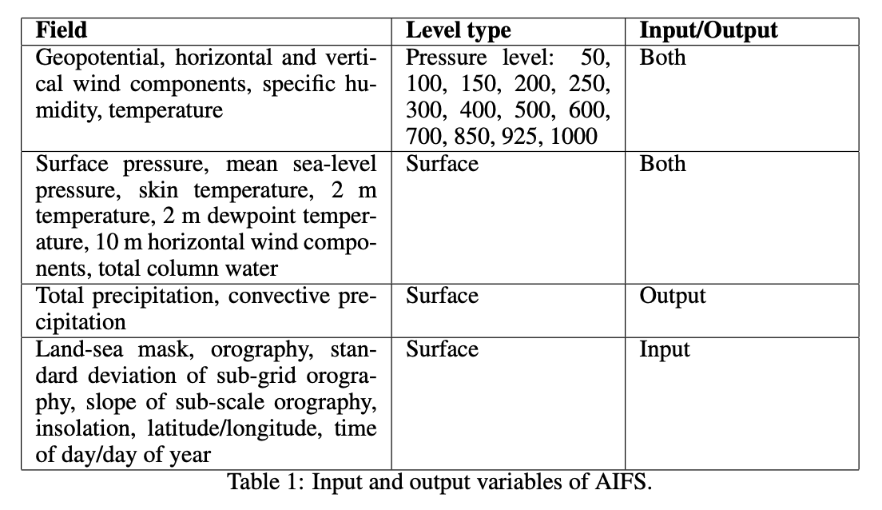
Notes about this approach
We can predict different outputs from the inputs
For example, here we’re only predicting temperature but we’re inputting temperature and wind speed
We can extend all these simple NN steps to be have multiple hidden neurons and hence much more complicated relationships through the node embeddings
(Sometimes node embeddings can be interesting to plot / explore)

Slide 9
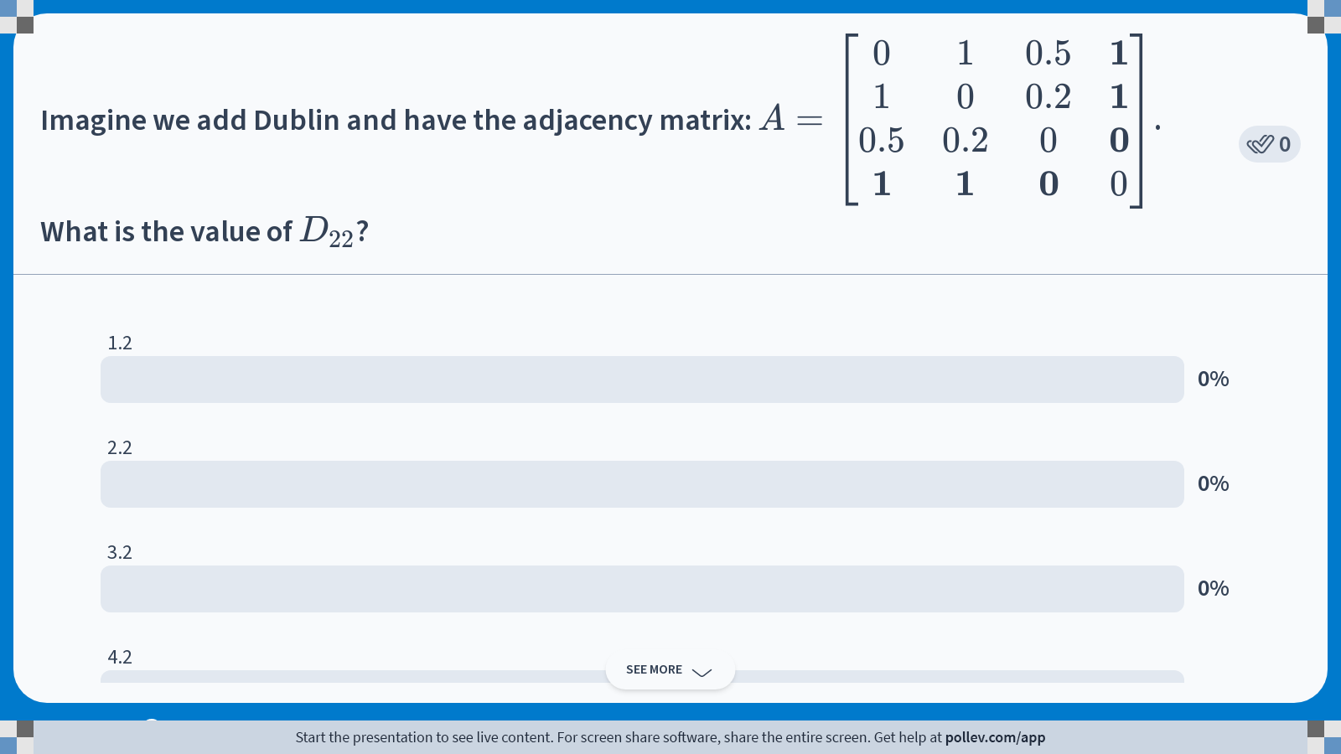
Notes:
Do not modify the notes in this section to avoid tampering with the Poll Everywhere activity. More info at polleverywhere.com/support Imagine we add Dublin and have the adjacency matrix: $$A = \begin{bmatrix} 0 & 1 & 0.5 & \mathbf{1} \\ 1 & 0 & 0.2 & \mathbf{1} \\ 0.5 & 0.2 & 0 & \mathbf{0} \\ \mathbf{1} & \mathbf{1} & \mathbf{0} & 0 \end{bmatrix}$$. What is the value of $$D_{22}$$?
https://www.polleverywhere.com/multiple_choice_polls/tTcCwBG944HpO30cTGShm?state=opened&flow=Default&onscreen=persist

Slide 10
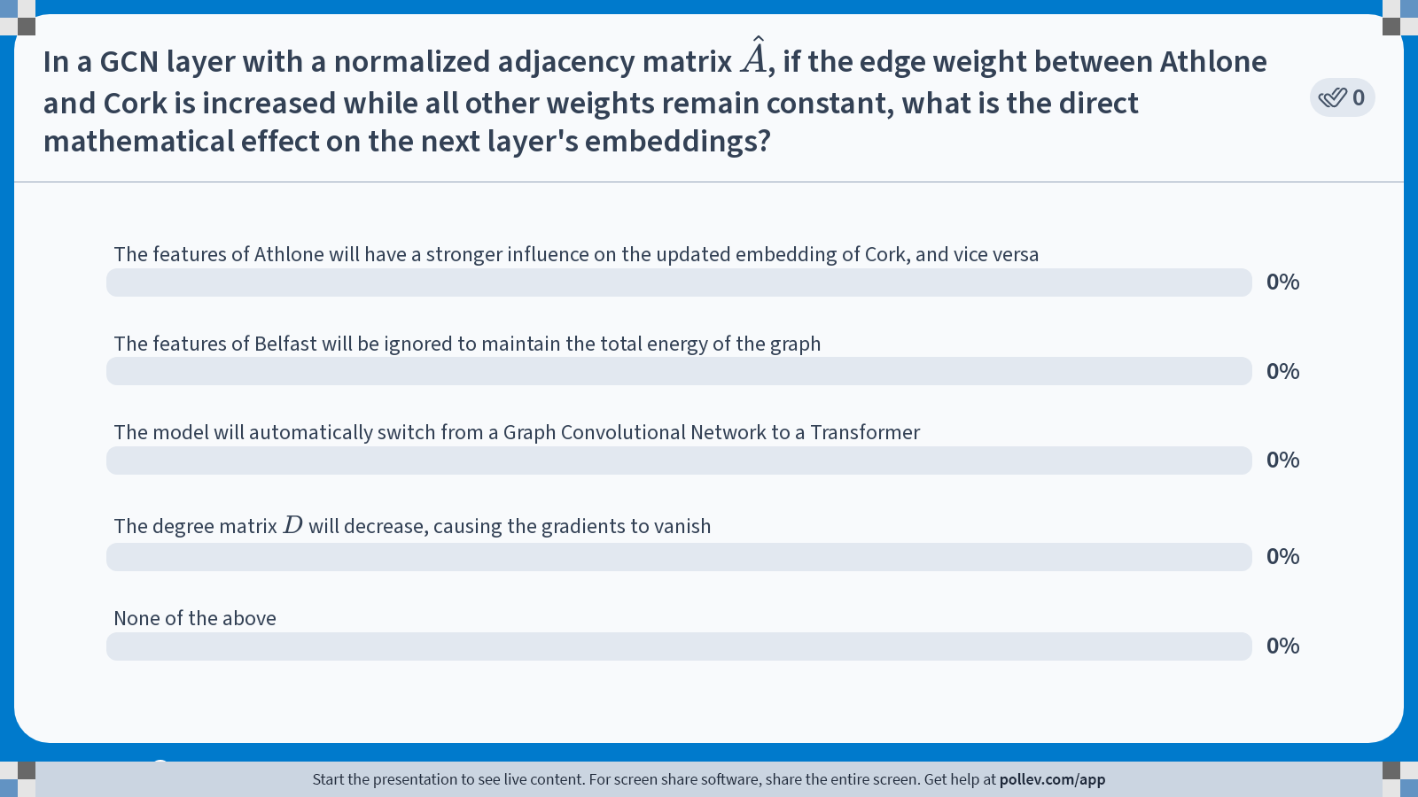
Notes:
Do not modify the notes in this section to avoid tampering with the Poll Everywhere activity. More info at polleverywhere.com/support In a GCN layer with a normalized adjacency matrix $$\hat{A}$$, if the edge weight between Athlone and Cork is increased while all other weights remain constant, what is the direct mathematical effect on the next layer's embeddings?
https://www.polleverywhere.com/multiple_choice_polls/clM2DHZ1dg0fR6SueU4WL?state=opened&flow=Default&onscreen=persist

Slide 11
Graph attention transformers
If we create the node embeddings for every time step in our data set, we can then add a transformer
Best explained with maths on the board

Slide 12
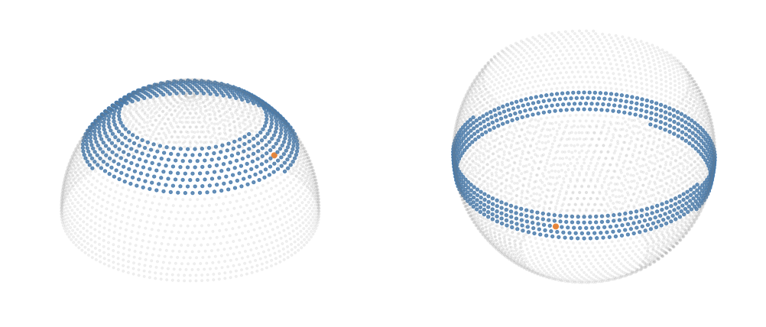
Other clever parts of AIFS
They use GELU activation functions to give smoother gradients (and removes kink at zero which helps models with more layers)
They use a clever mask for the attention weights via latitude bands
This restricts the attention mechanism and reduces the number of required parameters (but potentially sacrifices some teleconnections?)
Not entirely clear how they link together the larger ‘observation’ grid with the smaller ‘processor’ grid

Slide 13
Pytorch implementation
Our already defined GCN (1 layer) for e.g. 3 stations
A is the distance-based weights; self-loops are added inside
H are the node embeddings
Should really do this with torch_geometric but too big to fit on slide!
class TinyGCN(nn.Module):
def __init__(self, F=2, H=2):
super().__init__(); self.mix = nn.Linear(F, H); self.out = nn.Linear(H, 1)
def forward(self, X, A):
I = torch.eye(A.size(0), device=A.device); A = A + I
D = torch.diag(A.sum(1).pow(-0.5)); Ahat = D @ A @ D
H = F.relu(Ahat @ self.mix(X))
return self.out(H)
model = TinyGCN(F=2, H=2)
opt = torch.optim.Adam(model.parameters(), lr=0.1)
# Train (define X, A, y_next elsewhere)
for _ in range(300):
yhat = model(X, A); loss = (yhat - y_next).pow(2).mean()
opt.zero_grad(); loss.backward(); opt.step()

Slide 14
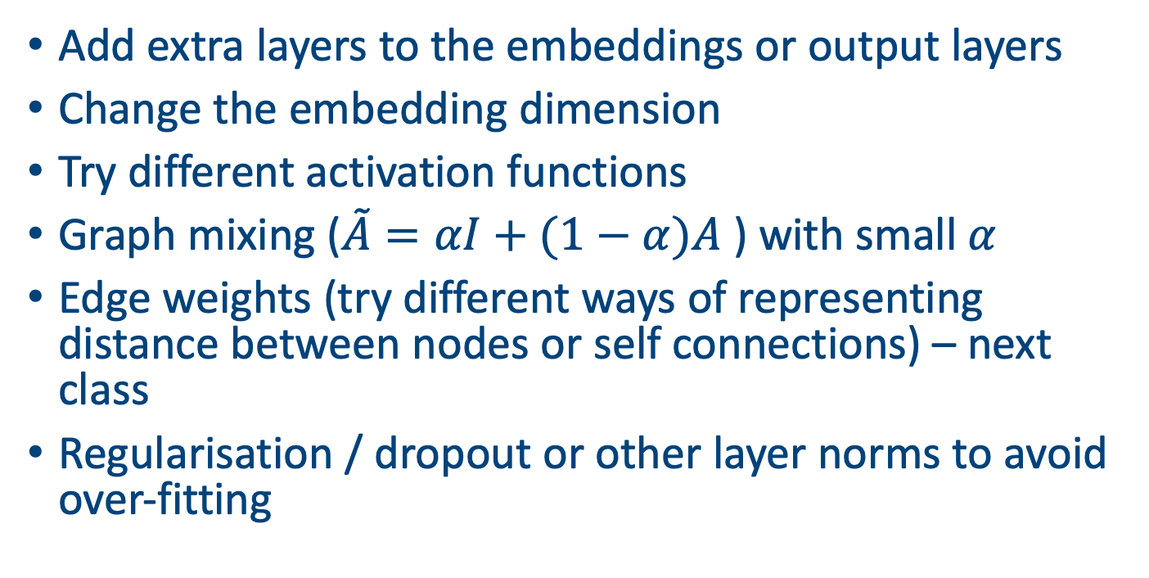
Ways to extend this model
Add extra layers to the embeddings or output layers
Change the embedding dimension
Try different activation functions
Graph mixing ($\tilde{A}=αI+(1−α)A$) with small $α$
Edge weights (try different ways of representing distance between nodes or self connections) – next class
Regularisation / dropout or other layer norms to avoid over-fitting

Slide 15
Advantages and disadvantages
Advantages
Captures spatial structure of complex systems (roads, power grids, sensor networks, weather stations)
Supports variable graph sizes and generalisation to new nodes
Reuses weights across locations for parameter efficiency
Challenges
Graph construction: deciding edges and weights
Scalability to large graphs (memory & computation)
Dynamic graphs and time‑varying edges

Slide 16
Practical tips
Preprocessing
Normalise features and scale adjacency weights
Handle missing data by imputation or masking (or use SERT)
Choose appropriate window sizes for temporal context
Training
Use mini‑batching with neighbour sampling for large graphs
Monitor validation metrics and avoid overfitting
Leverage GPUs and sparse operations for efficiency

Slide 17
Summary
GNNs generalise neural networks to (irregular) graph structures
GCN layers normalise adjacency and aggregate neighbour features
Can combine with transformers to assign dynamic importance to neighbours
Weather forecasting benefits from capturing spatial relationships
Frameworks like PyTorch Geometric make implementation practical

